Slide 1
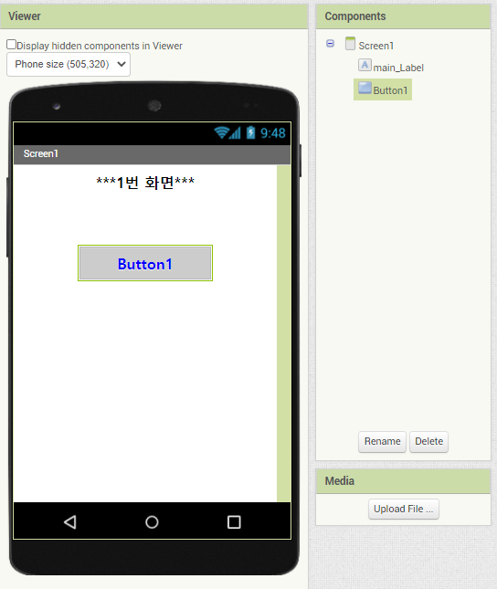
PPT PRESENTATION
Enjoy your stylish business and campus life with BIZCAM
라벨 네임 : main_Label
라벨 글씨 크기 : 25
“ 높이 : 20%
“ 너비 : 50%
버튼 네임 : Button1
버튼 글씨 크기 : 20
“ 높이 : ?%
“ 너비 : ?%
나머지는 보이는대로

Slide 2
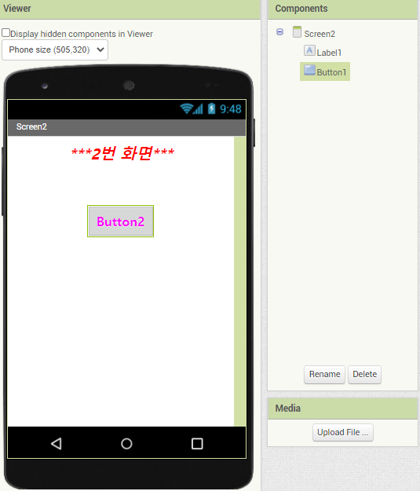
PPT PRESENTATION
Enjoy your stylish business and campus life with BIZCAM
라벨 네임 : Sub_Label
라벨 글씨 크기 : 25
“ 높이 : 20%
“ 너비 : 50%
버튼 네임 : Button2
버튼 글씨 크기 : 20
“ 높이 : 50 픽셀
“ 너비 : 200 픽셀
나머지는 보이는대로

Slide 3
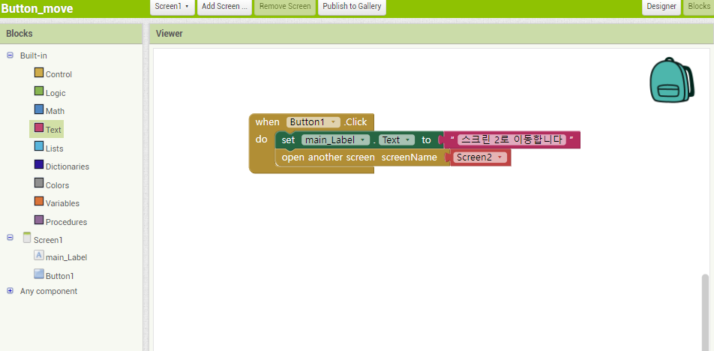
PPT PRESENTATION
Enjoy your stylish business and campus life with BIZCAM

Slide 4
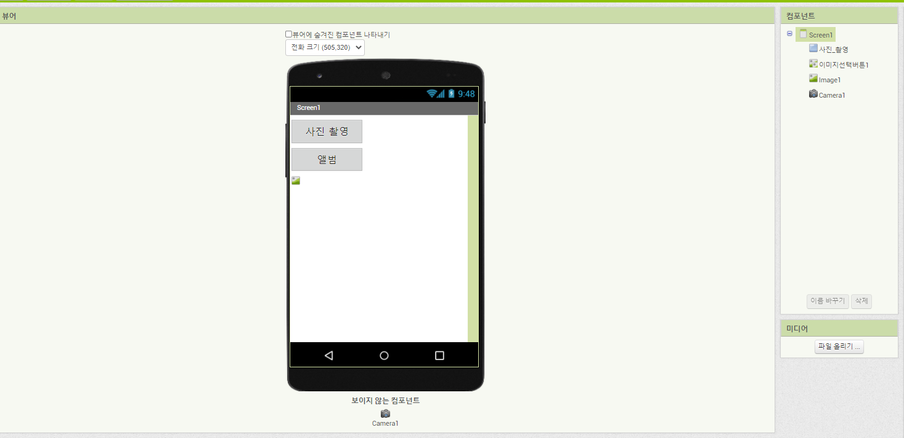
PPT PRESENTATION
Enjoy your stylish business and campus life with BIZCAM

Slide 5
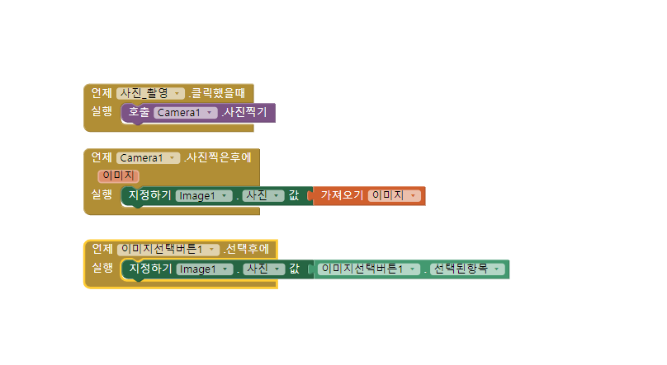
PPT PRESENTATION
Enjoy your stylish business and campus life with BIZCAM

Slide 6
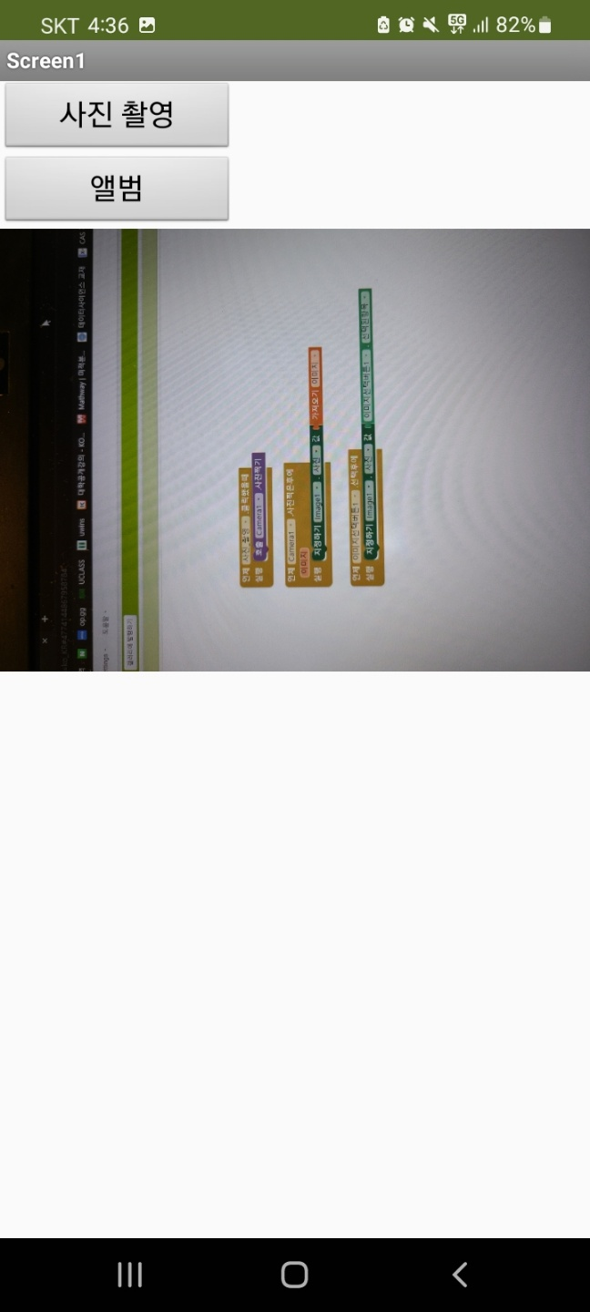
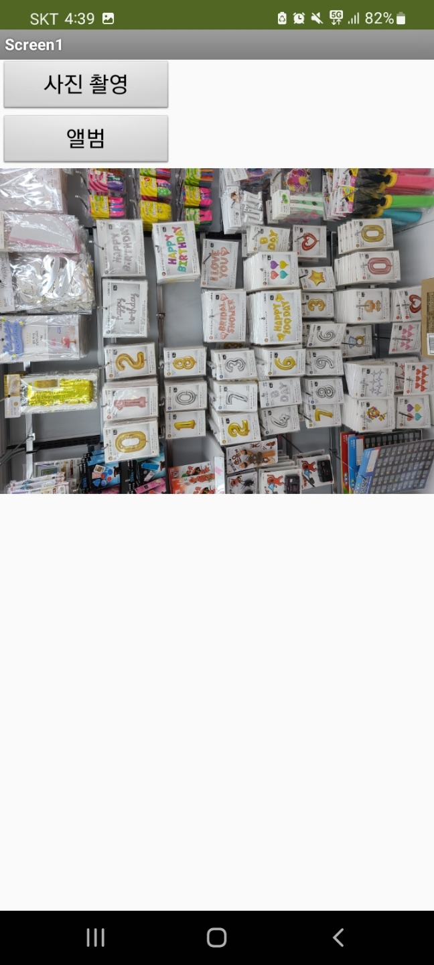
PPT PRESENTATION
Enjoy your stylish business and campus life with BIZCAM

Slide 7
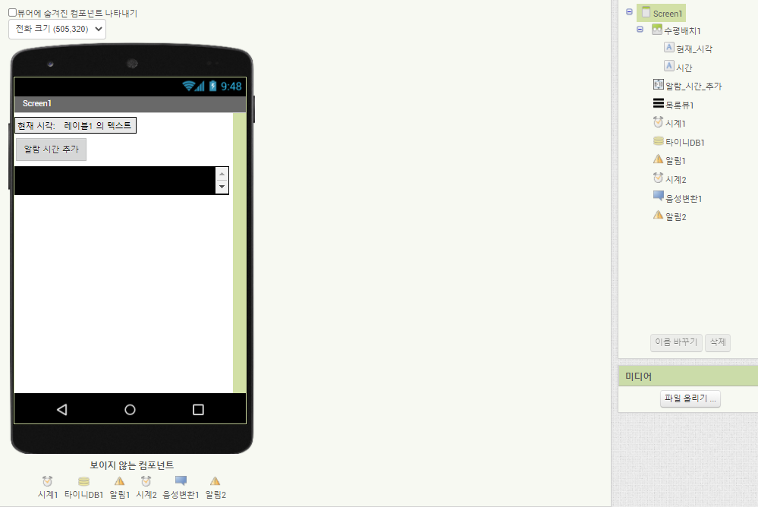
PPT PRESENTATION
Enjoy your stylish business and campus life with BIZCAM

Slide 8
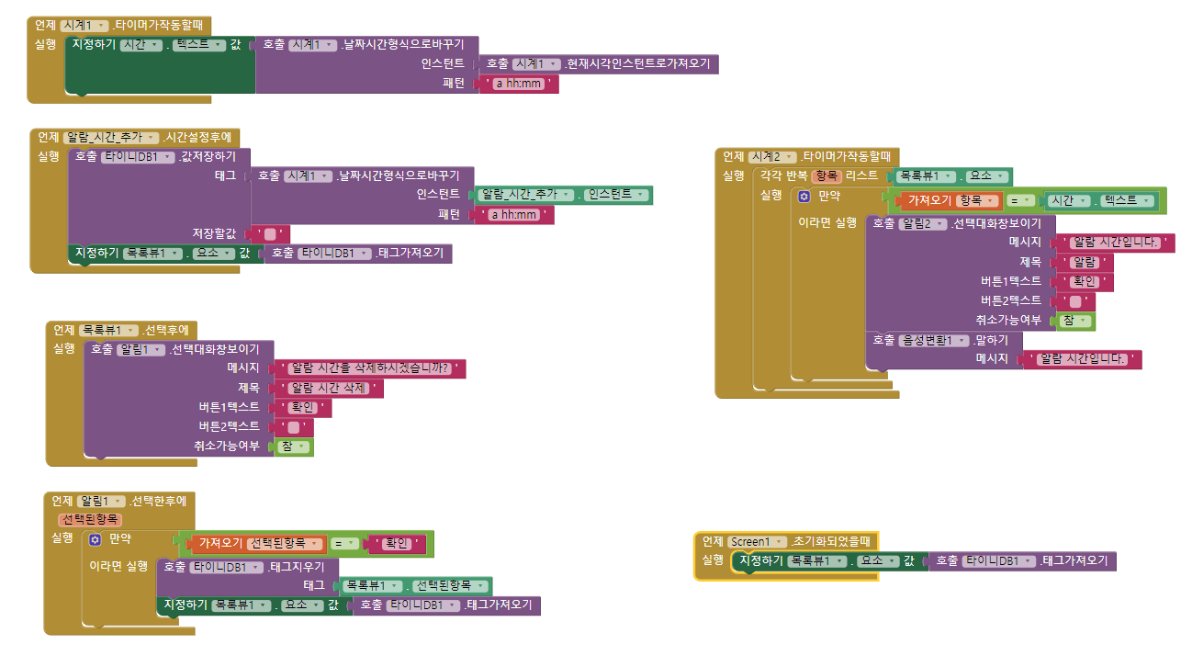
PPT PRESENTATION
Enjoy your stylish business and campus life with BIZCAM

Slide 9
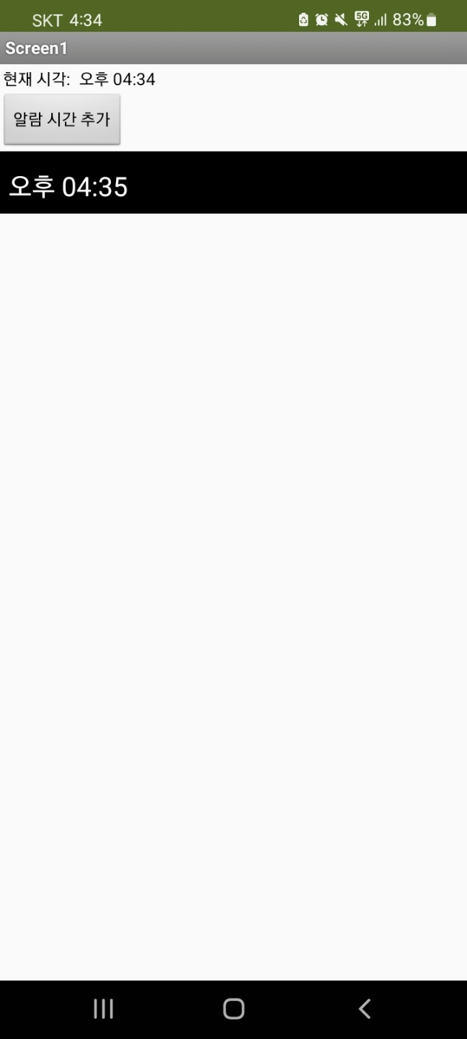
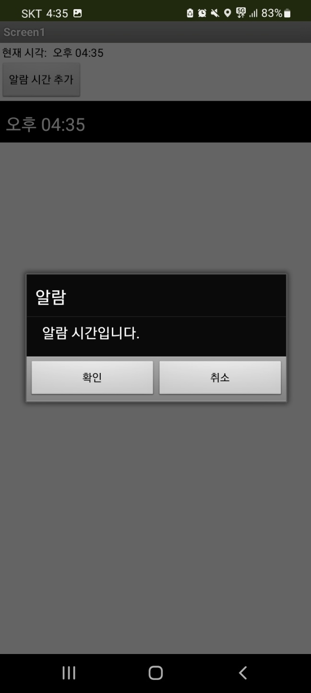
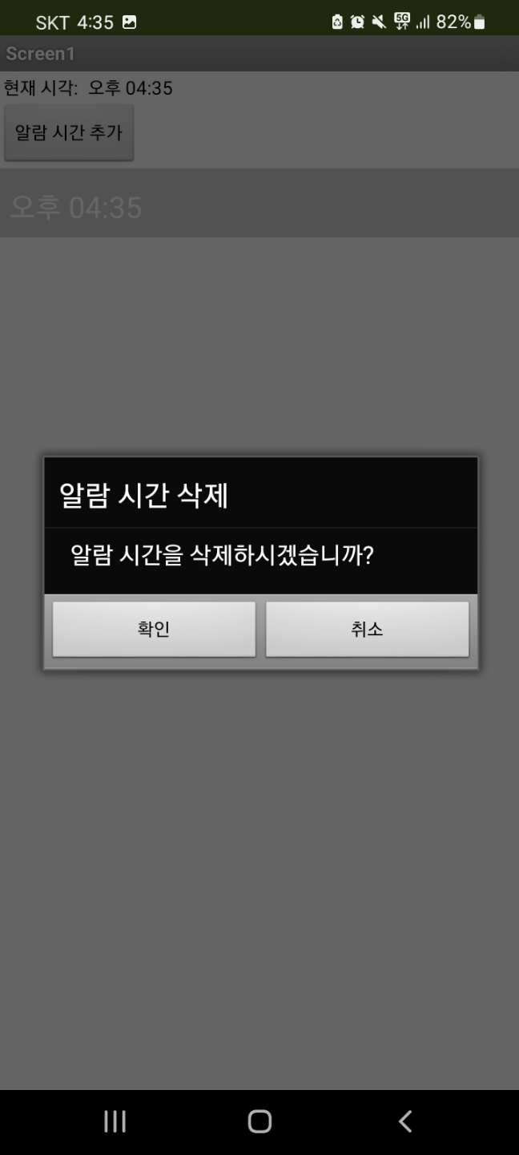
PPT PRESENTATION
Enjoy your stylish business and campus life with BIZCAM

Slide 10
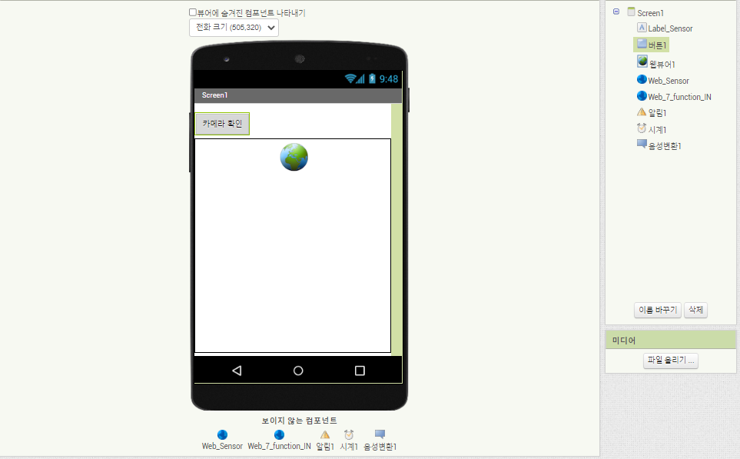
인체감지센서 앱인벤터
Web_Sensor
http://192.168.35.79:8000/*
Web_7_funtion_IN
http://192.168.35.79:8000/GPIO/7/function/IN

Slide 11
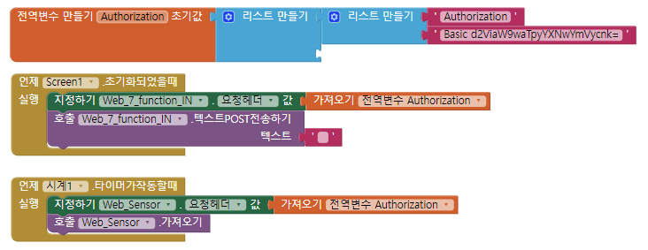

인체감지센서 앱인벤터

Slide 12
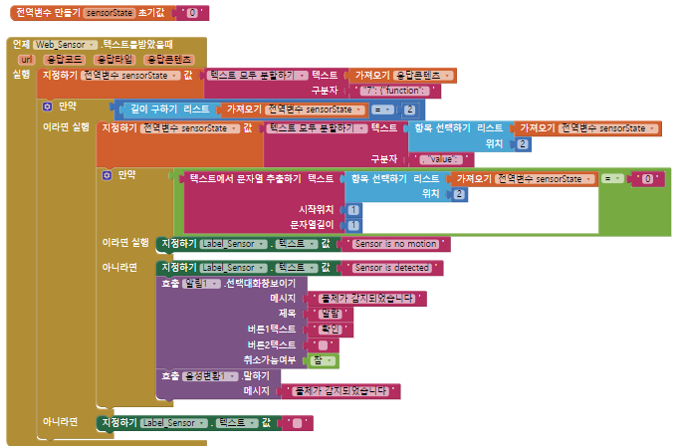
인체감지센서 앱인벤터

